Slide 1

Extracting And Analyzing Information In User-Support Conversations On Twitter
Under the Guidance of
D. Sangeetha
Assistant Professor
Team:18
16WH1A1236 - P. Harshitha
16WH1A1242 - N. Sai Charitha
16WH1A1253 - R. Yamini

Slide 2
Contents
Introduction
Problem Definition
Literature Survey
Proposed System
Architecture Diagram
Phase(s)
Plan of Action
References

Slide 3
Introduction
Modern apps include options to support users in providing relevant, complete, and correct context information when reporting bugs or feature requests.
Despite the presence of such options, an increasing amount of users still report their issues via social media, such as Twitter.

Slide 4
Problem Definition
The reporting process in social media is unstructured and the feedback often lacks basic context information, such as the app version or the device concerned when experiencing the issue.
Solution:
We introduce an unsupervised approach that uses pre-defined keyword lists, word vector representations, text patterns to extract context items from tweets, including the platform, device, app and system versions and combined with a chatbot that automatically requests missing context items from reporting users, our approach aims at auto-populating issue trackers with structured bug reports.

Slide 5
Literature Survey
Crawled dataset
Issue trackers
Tweepy – Twitter API
Dependent (operate in response to conditions) responder/ keywording replying bot
JSON data

Slide 6
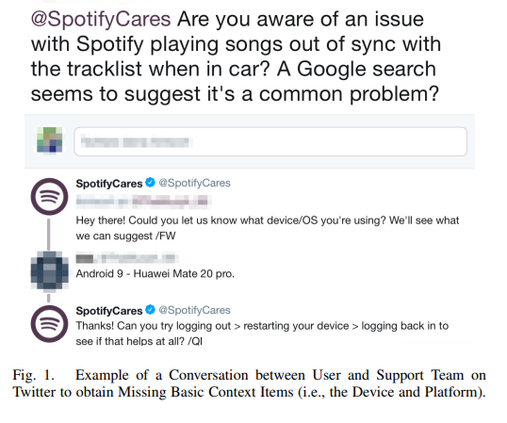
Proposed System
We aim to automatically extract basic context items from tweets. Our approach is intended to be used in combination with a feedback classification and a chat-bot approach to auto-populate issue trackers with structured bug reports mined from user feedback

Slide 7
Architecture Diagram
Support account tweets
User tweets using the mention of the support account
Reply from the bot
Issue Tracker
Extracted with the help of API calls
Raw bug report is generated

Slide 8
Phases
Dataset collection and understanding the tweet structure
Bot creation
Final generation of the report

Slide 9
Phase 1: Dataset collection and understanding the tweet structure
The crawled dataset is extracted from twitter
The tweets which are extracted are considered as a raw data
Converting into a JSON format
Creation of the intents
9

Slide 10
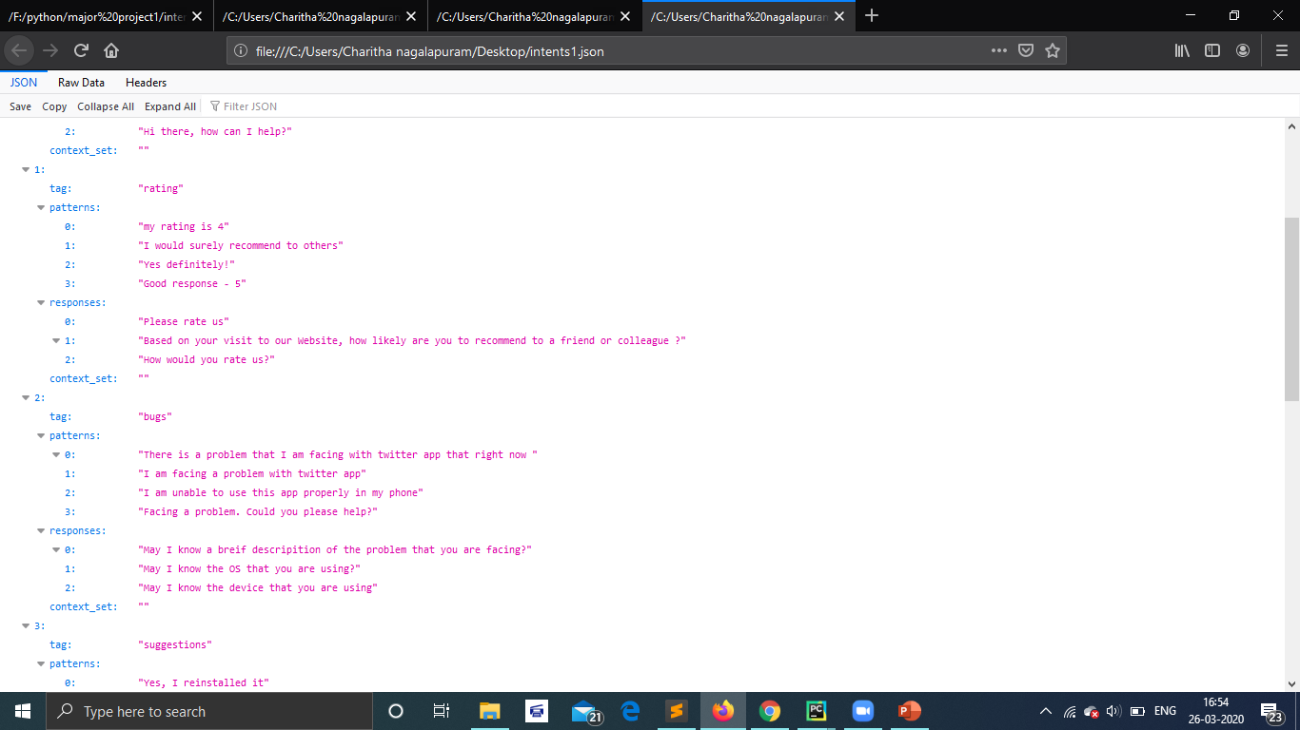
Some of the intents for the chatbot

Slide 11
Phase 2: Bot creation
We have created a twitter bot which replies to the tweet in which its is mentioned.
Libraries which are used for this bot are twit, and chatterbot which are used to build the bot.
With the help of the intents in JSON format and LancasterStemmer module in the NLTK library the will try to understand the data given by the user.
11
11

Slide 12
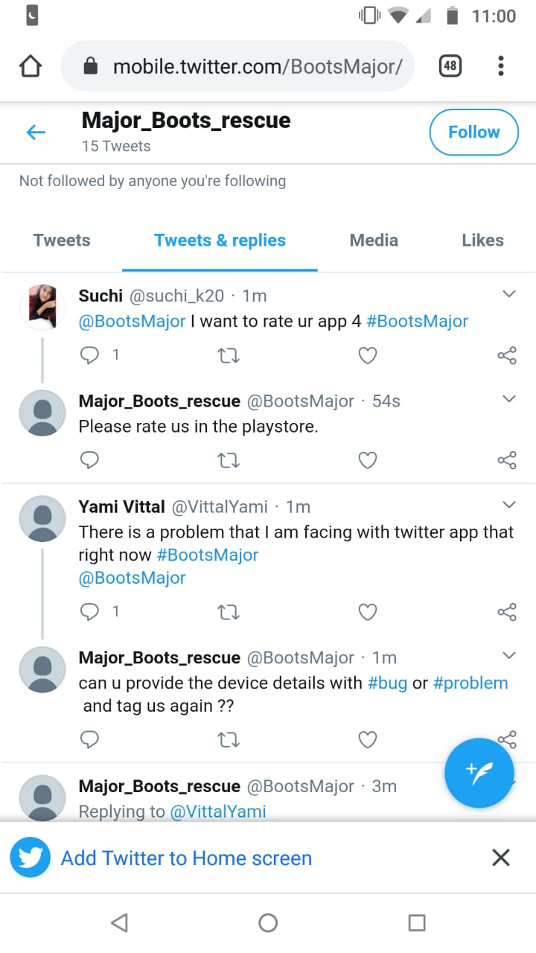

Bot replying to the mentioned tweets.
To checkout: Tweet your queries with mention @BootsMajor and a #BootsMajor

Slide 13
Phase 3: Final generation of the report
This is phase we will be extracting the tweets for the twitter with the help of the API from the respective support account.
These tweets will then be classified into different categories like rating, feature recommendation and bug reports.
The tweets which are extracted will be considered as the raw bug report.
We will tokenize the user feedback and retrieve the context items from the text and build the final report with context items and the text from the tweets to the issue tracker.
13
13
13

Slide 14
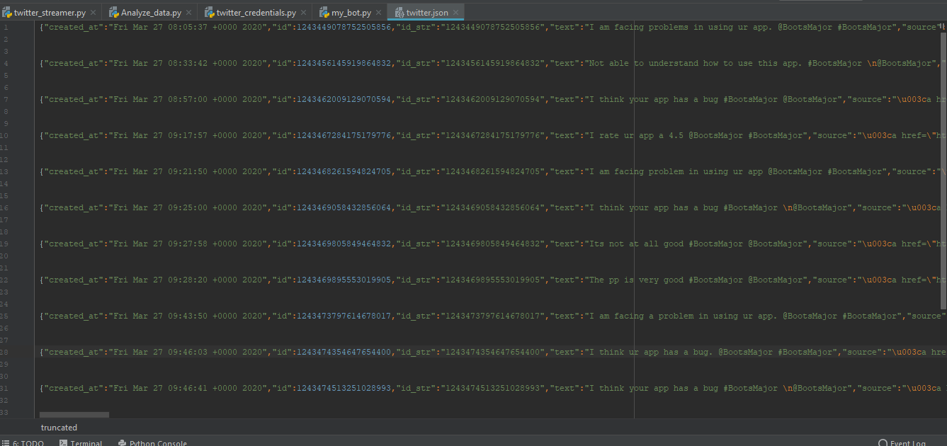
JSON data which is extracted from the support account. This data is considered to be a raw data

Slide 15
Conclusion and future scope
Conclusion
Despite built-in options to report issues in a structured manner, users continue to share a large amount of unstructured, informal feedback on software products via social media. So we have come up with this chat-bot approach in order to auto populate the issue trackers.
Future scope
In the future we will try to solve the compatibility issues and make the flow of the system even more smooth and easy.

Slide 16
Action Plan
Module Information | Status | Time required to Complete
Literature Survey | Completed | 2 Weeks
Dataset Collection and understanding of the tweet structure | Completed | 1 Week
Design | Completed | 1 Weeks
Bot construction and generating report | Completed | 3 Weeks
Documentation | Completed | 2 Weeks

Slide 17
References
Base Paper – Information
Base Paper - arXiv:1907.13395v1 [cs.SE] 31 Jul 2019
T. F. Bissyand, D. Lo, L. Jiang, L. Rveillre, J. Klein, and Y. L. Traon, a large scale investigation of issue trackers from github,” in 2013 IEEE 24th International Symposium on Software Reliability Engineering.
Twitter, Twitter Search API, April 2019, https://twitter.com/i/search/ timeline.
Snapchat, Ofﬁcial Snapchat Support Account on Twitter, April 2019, https://twitter.com/snapchatsupport.
Spotify, Ofﬁcial Spotify Support Account on Twitter, April 2019, https: //twitter.com/SpotifyCares.

Slide 18
THANK YOU

